Slide 1
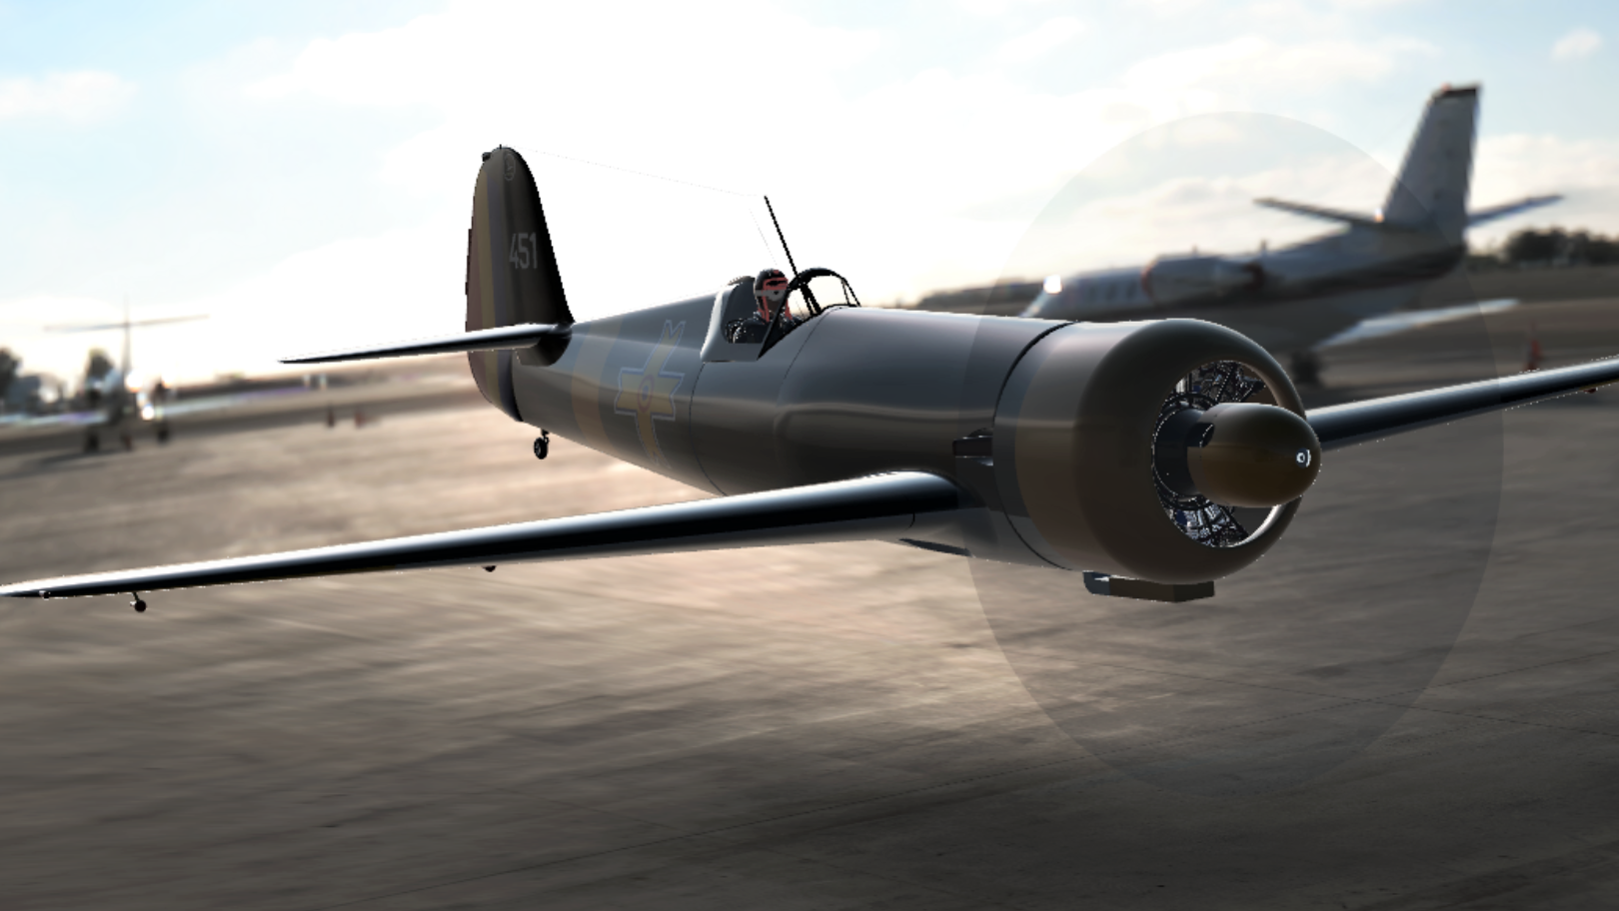
IAR80FA Ribs - Spring back analysis
Presentation by
CAMARASU Alexandra-Cristina
CAMARASU Genoveva-Ilinca
:

Slide 2
Summary
The scope of the spring back analysis
Introduction to Altair Inspire Form
Model Setup
Results
Conclusions

Slide 3
References
[1] Forming Methods - Forming by single-action hydraulic press, Bureau of Aeronautics Navy Department - Washington D.C. 1943
[2] Prediction algorithm for spring back of frame-rib parts in rubber forming process by incorporating
Sobol within improved grey relation analysis, Yubin Fan, Chuang Liu, Junbiao Wang
[3] Altair Inspire Form product documentation
[4] www.matweb.com

Slide 4
The scope of the spring back analysis (1/3)
The spring back of a sheet metal is the geometric change made to a part at the end of the forming process when the load is removed.
There are two basic views as to why spring back occurs, one states that it is due to the displacement of the molecules and the other considers the spring back in terms of a stress-strain diagram.
The integration of the spring back into the design of the forming process represents a significant challenge due to the difficulties associated to its prediction.
For a given process, the material properties like flow stress, young's modulus and strain hardening coefficient determine the magnitude of the spring back. A material with a higher elastic modulus will show less spring back than a material with a lower elastic modulus.

Slide 5
The scope of the spring back analysis (2/3)
In recent years, many researches were conducted to predict the spring back using advanced CAE techniques and in order to develop numerical optimization procedures to control spring back of sheet metal parts.
Specific to IAR80FA, a spring back analysis was conducted using Altair Inspire Form in order to compare the simulation results with the actual spring back of the parts produced at Avioane Craiova SA.
Several ribs of the Horizontal Stabilizer and Wing were selected for the analysis. These ribs are made of Al2024-O (initial temper), formed in a Muller 6000tf hydraulic press, after which are further treated to the final temper T42.

Slide 6
The scope of the spring back analysis (3/3)

Slide 7
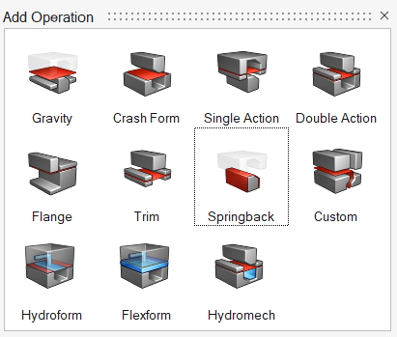
Introduction to Altair Inspire Form (1/4)
What is Altair Inspire Form?
It is a sheet metal forming simulation software, that can be used to:
predict formability of the part early in the development phase
simulate forming, trimming or spring back of parts
Why Altair Inspire Form?
It is easy to use and it helps to:
design better products,
save materials, time and costs.

Slide 8
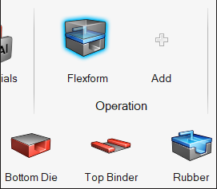
Introduction to Altair Inspire Form (2/4)
What is Flexform?
Simulates a top binder holding the blank of a model while fluid in a rubber membrane deforms the blank against the bottom die.
Definitions:
The bottom die is a stationary tool that is used as a reference for all auto-positions. The location for the bottom die is always below the blank.
The top binder provides a holding surface above the blank in order to grip the perimeter of blank against the bottom die during the forming operation.

Slide 9
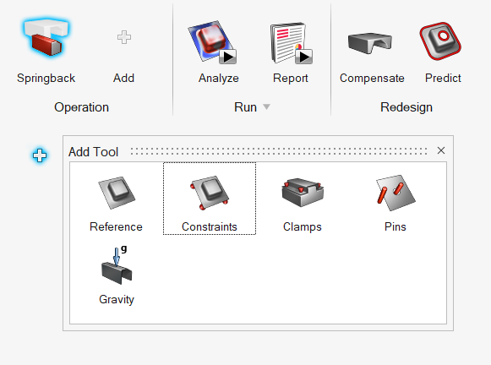
Introduction to Altair Inspire Form (3/4)
Spring back in Inspire form
Analyze the elasto-plastic stress gradients that build up across the surface of a blank during forming and cause the blank to bounce back and deviate from the desired shape.
Spring back analysis requires a reference part and constraints.

Slide 10
Introduction to Altair Inspire Form (4/4)
Inspire Form was released in 2021. The Flexform operation was added in 2022, thus there are only few details related to this type of analysis. Furthermore, in the 2023 version (latest), spring back displacement is contoured correctly along the x, y, and z axes.
Both 2022.3 and 2023 versions were tested for current analysis, but their comparison is not treated in this presentation. Only the results obtained with Inspire Form 2023 are further presented.

Slide 11
Model Setup
Geometry
Materials
Tool Set
Run Options

Slide 12
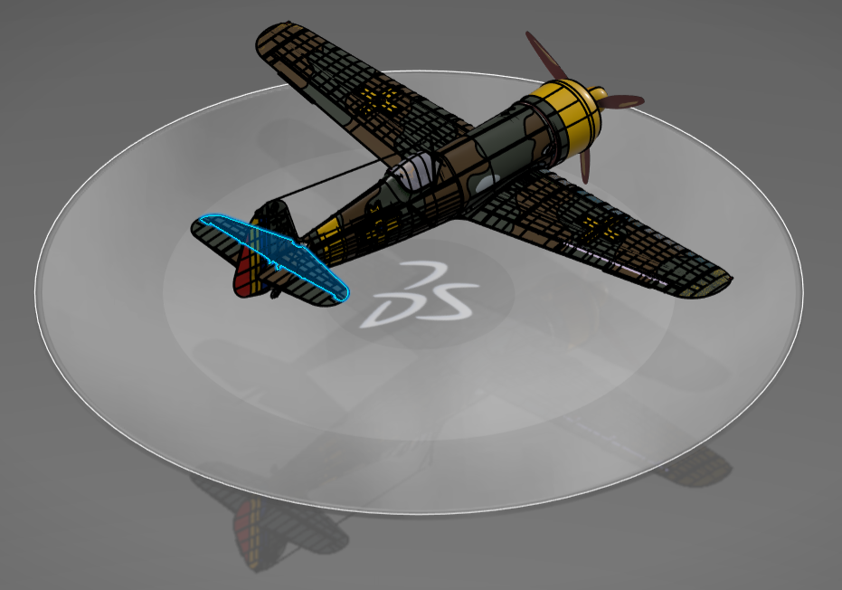
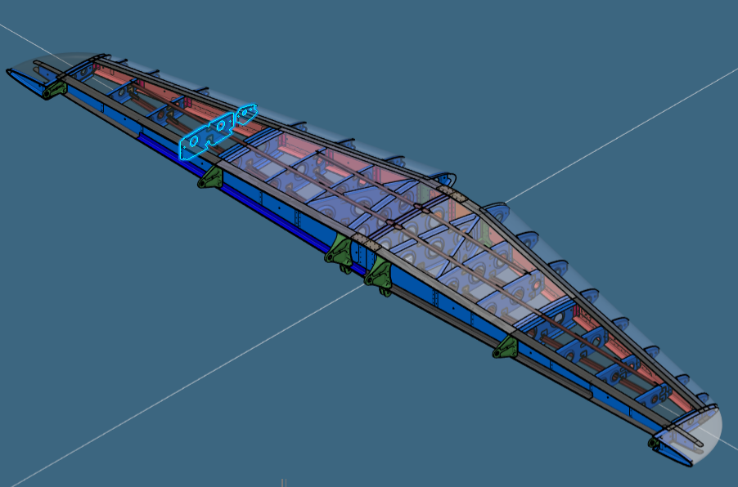
Geometry (1/5)
Horizontal Stabilizer (HS) – Leading Edge (LE) and Central Ribs

Slide 13
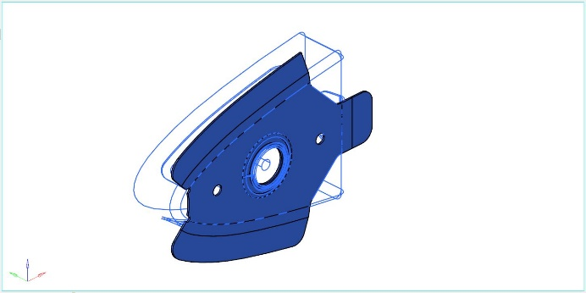
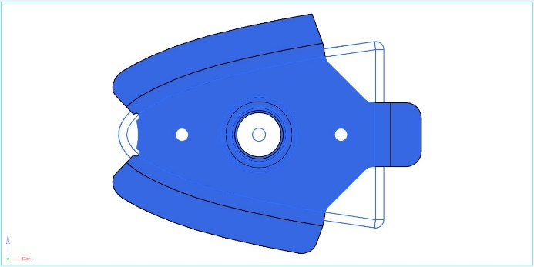
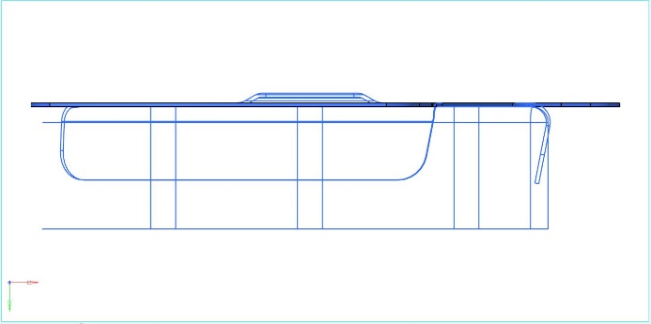
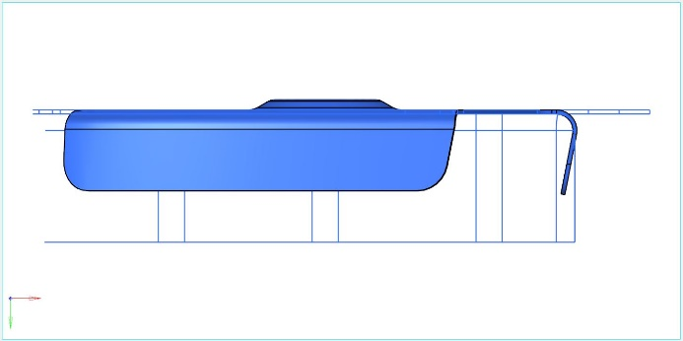
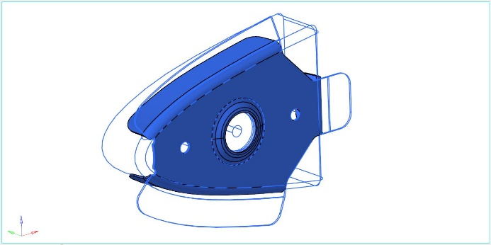
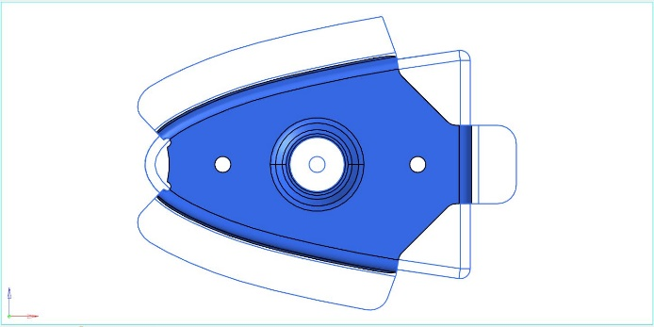
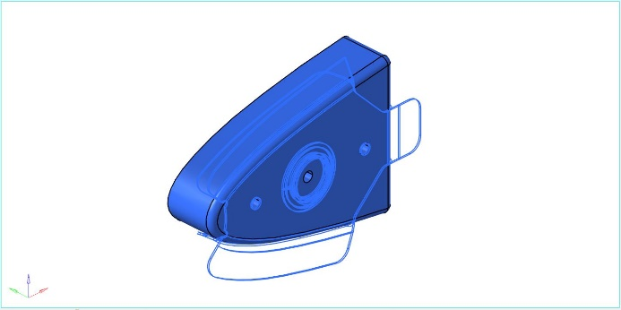
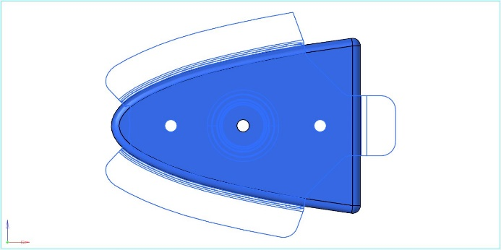
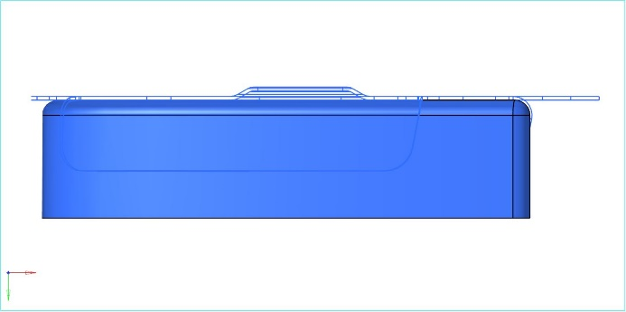
Geometry (2/5)
Horizontal Stabilizer (HS) – Leading Edge (LE) and Central Ribs
Unfolded
Folded
Die

Slide 14
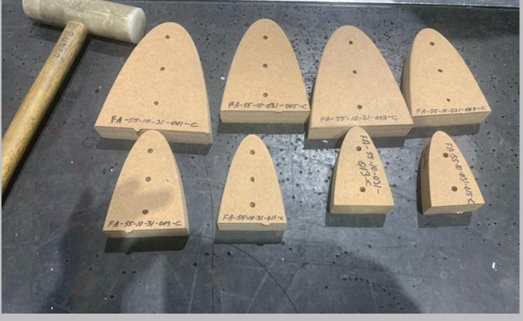
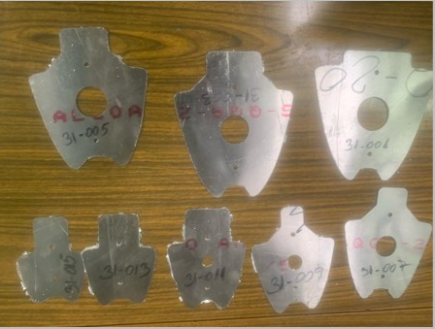
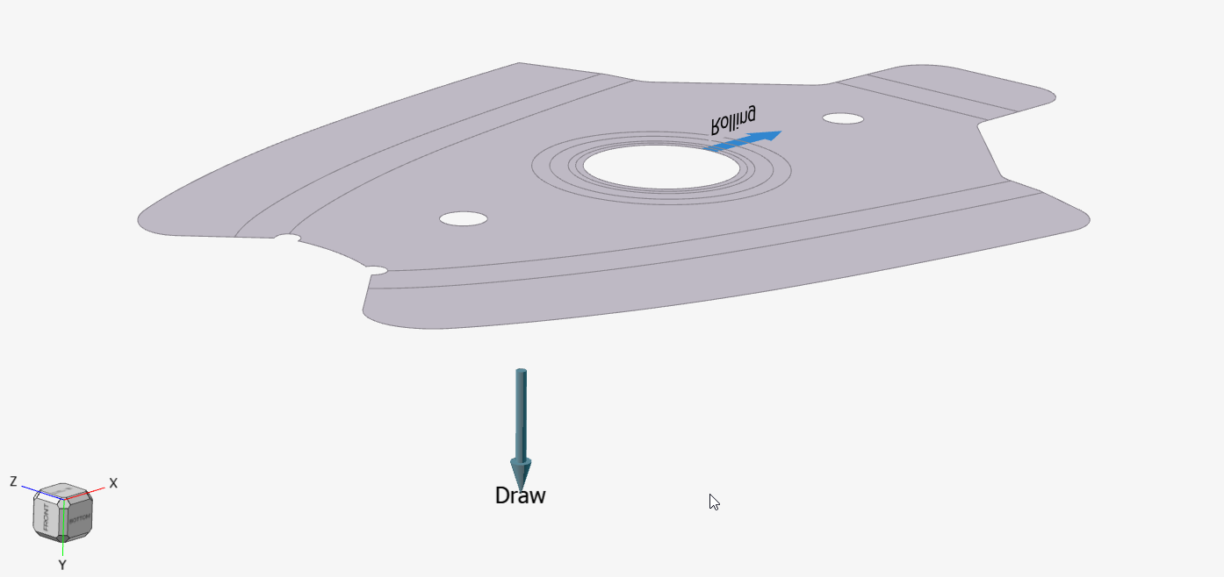
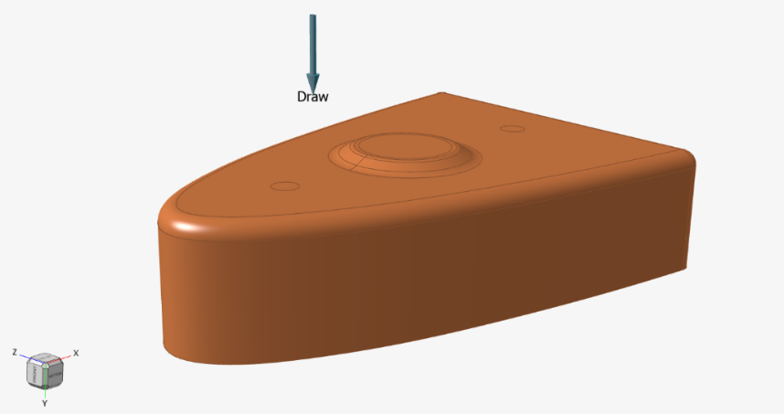
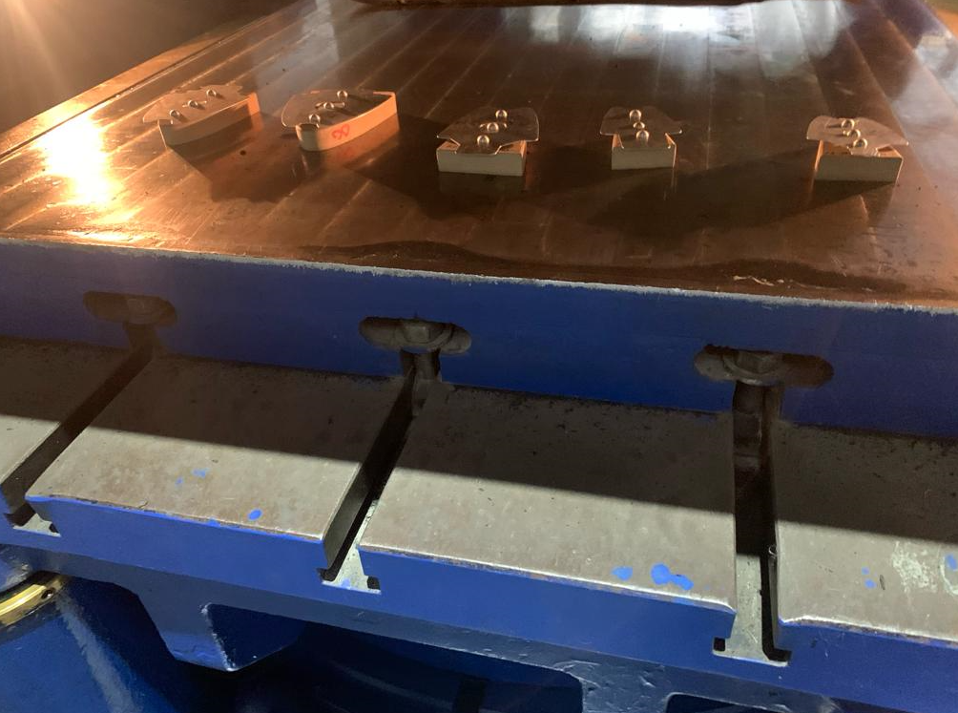
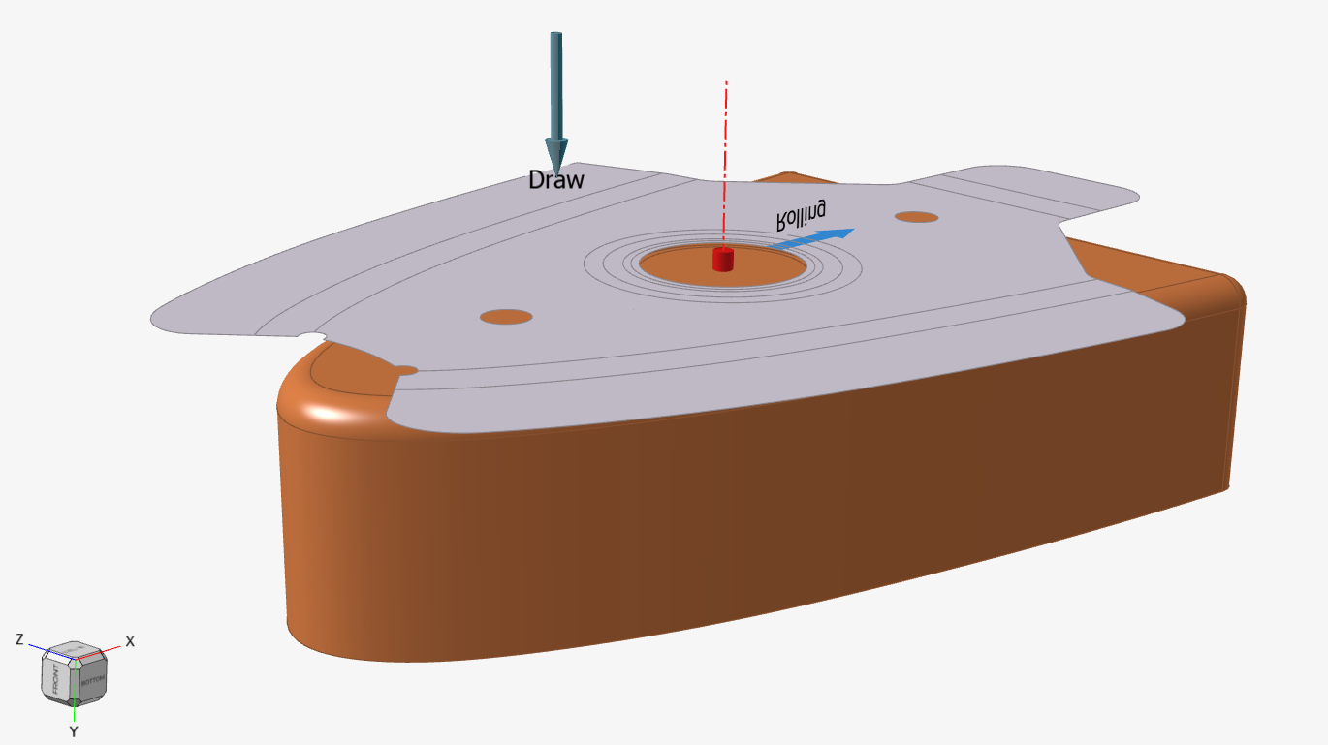
Geometry (3/5)
Horizontal Stabilizer (HS) – Leading Edge (LE) Rib
Blank
Bottom Die
Assy in hydraulic press

Slide 15
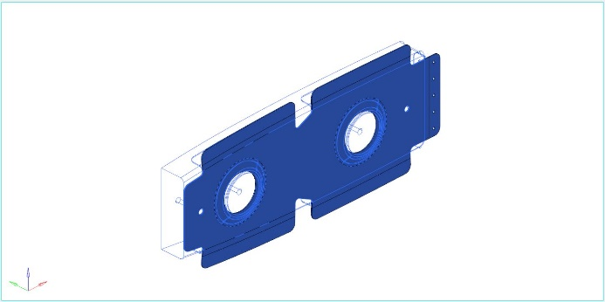
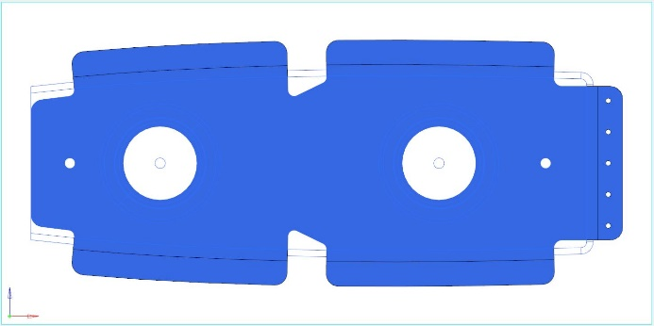
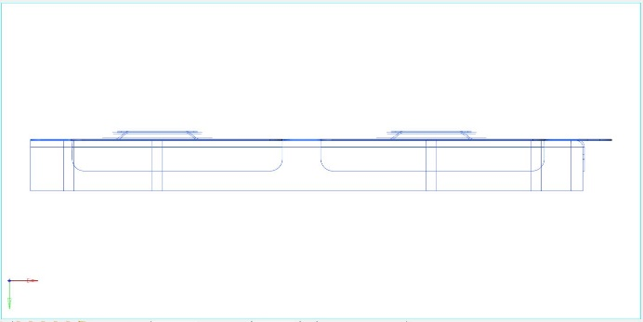
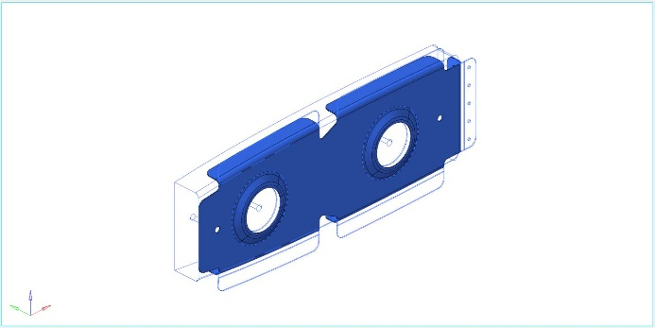
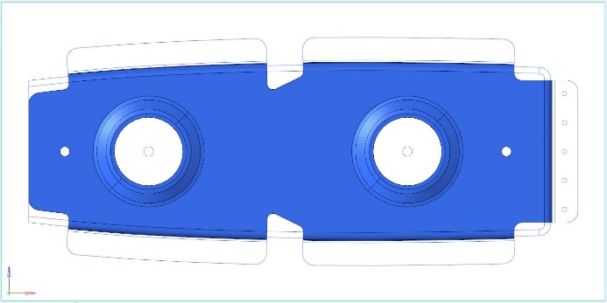
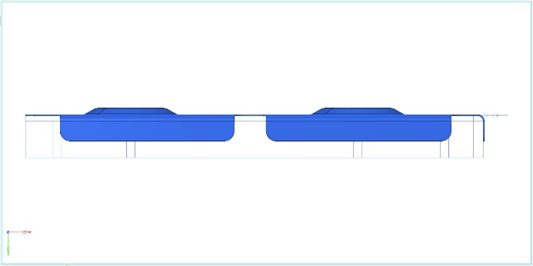
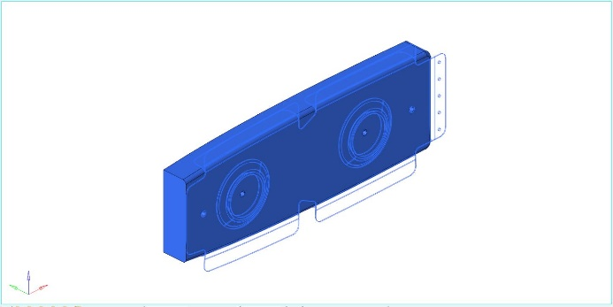
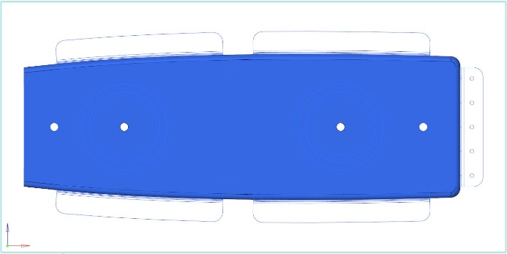
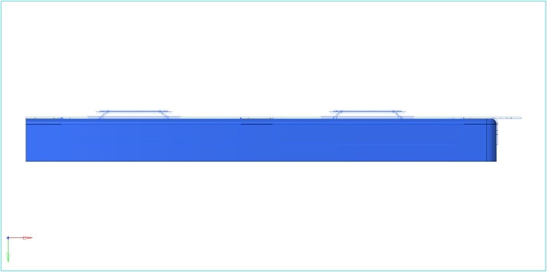
Geometry (4/5)
Horizontal Stabilizer (HS) – Central Rib
Unfolded
Folded
Die

Slide 16
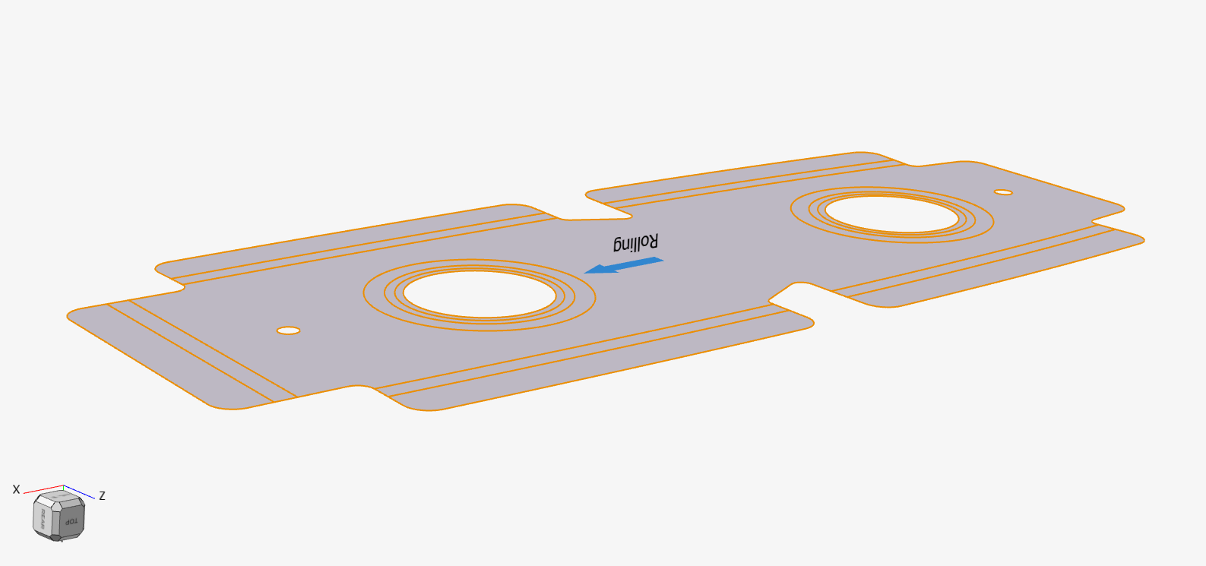
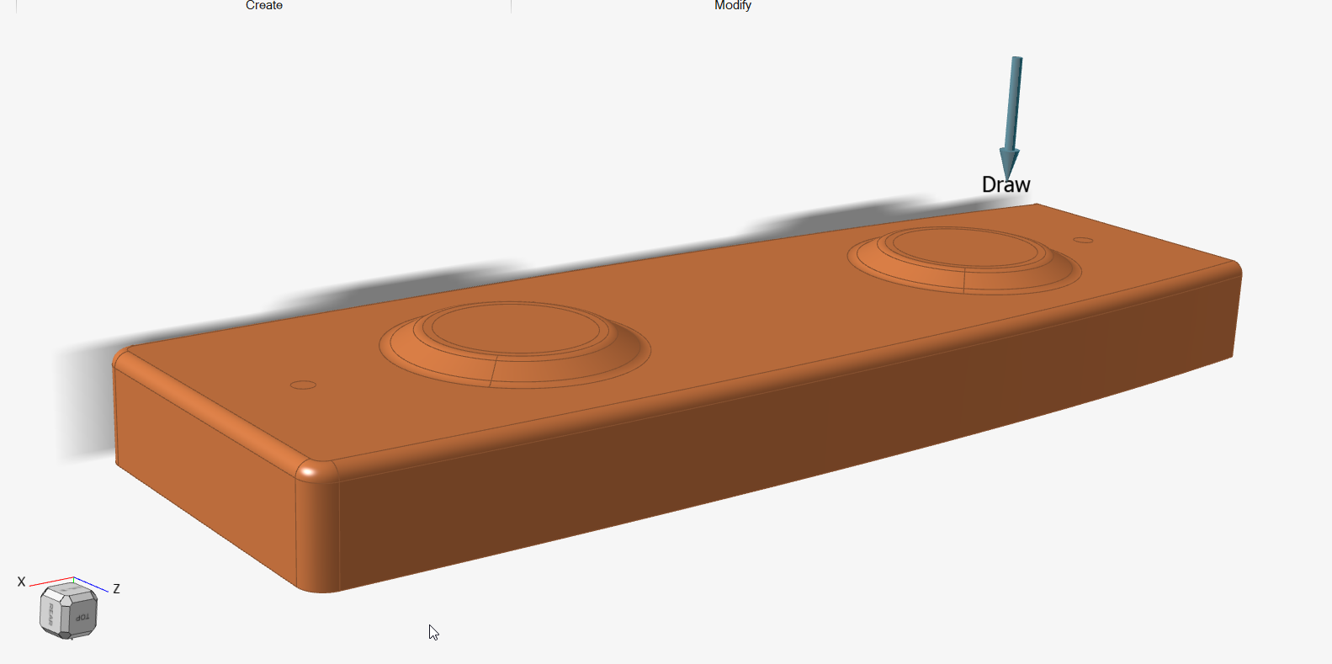
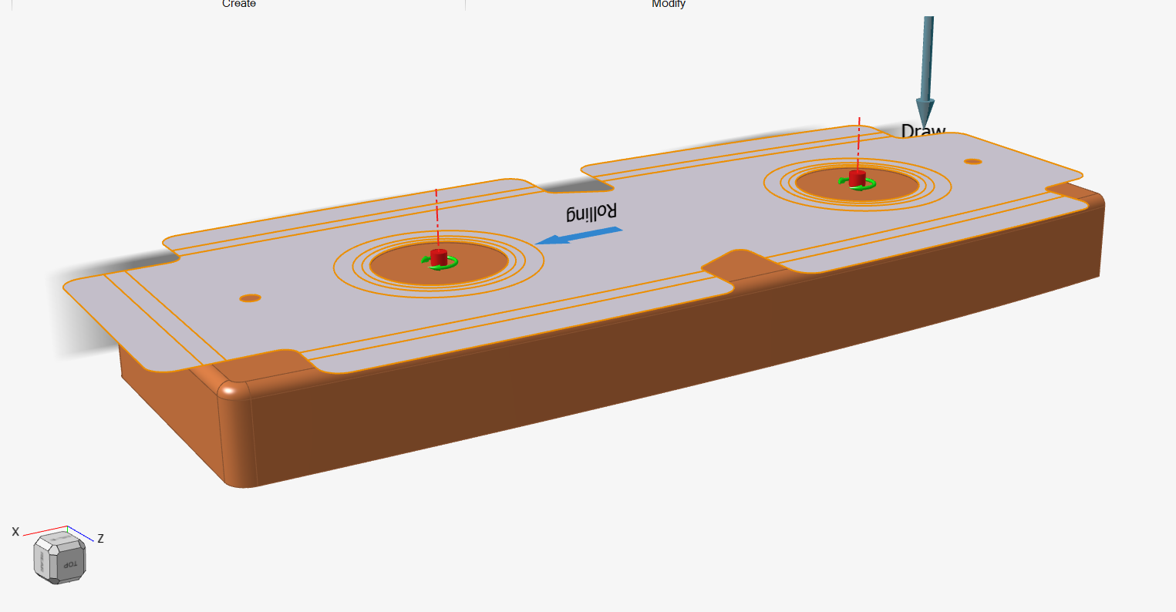
Geometry (5/5)
Horizontal Stabilizer (HS) – Central Rib
Blank
Bottom Die
Assy in hydraulic press

Slide 17
Materials (1/4)
For each part, the following materials are attributed:
Blank – AL2024-O
Rubber Membrane – Rubber (Urethane)
Top Binder – Rubber (Urethane)
Bottom Die – MDF
The material properties were mainly taken from www.matweb.com. For rubber, average values were used as the actual properties of the rubber pad used at Avioane Craiova are unknown for the moment.
Also, for each material the FLC (Forming Limit Curve) is the default one (due to lack of other information).
Forming Limit Curve is a function of the metal grade, thickness, sheet surface conditions and methods used during its creation.

Slide 18
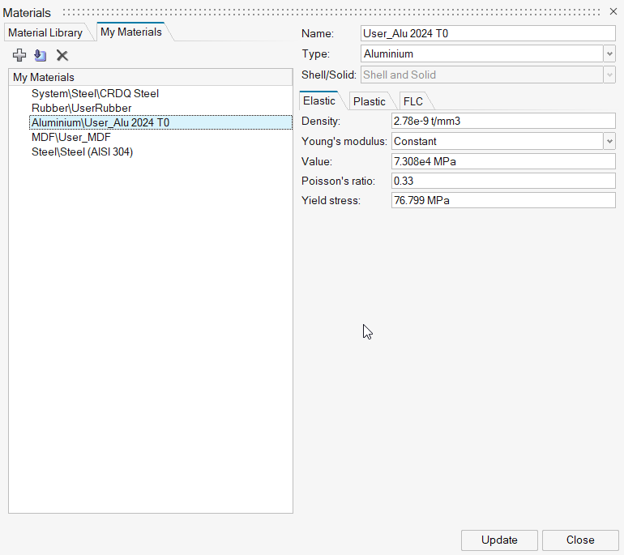
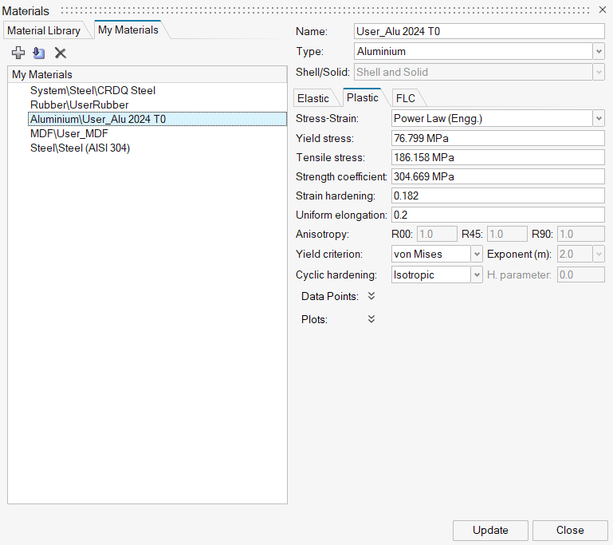
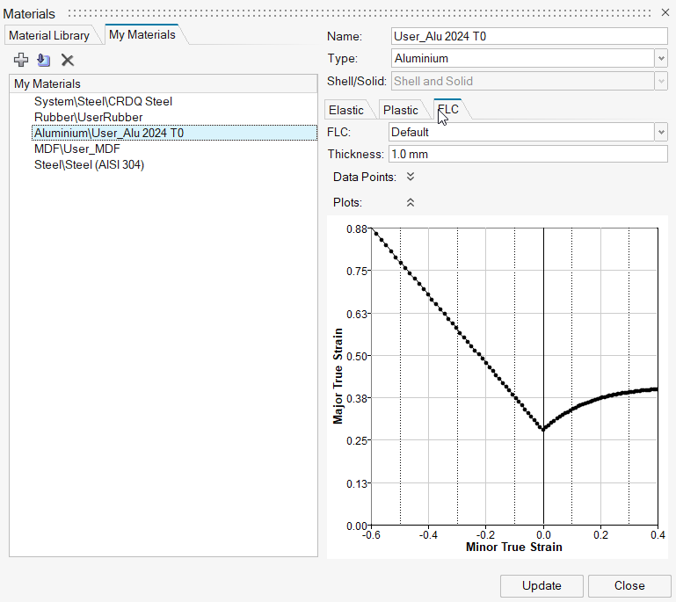
Materials (2/4)
Aluminum 2024-O

Slide 19
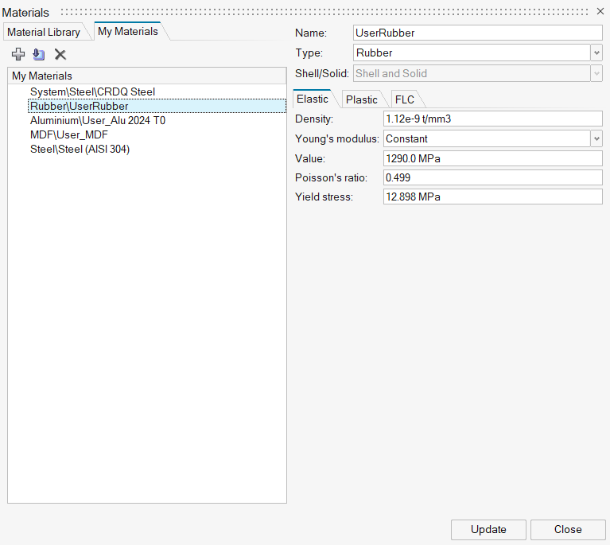
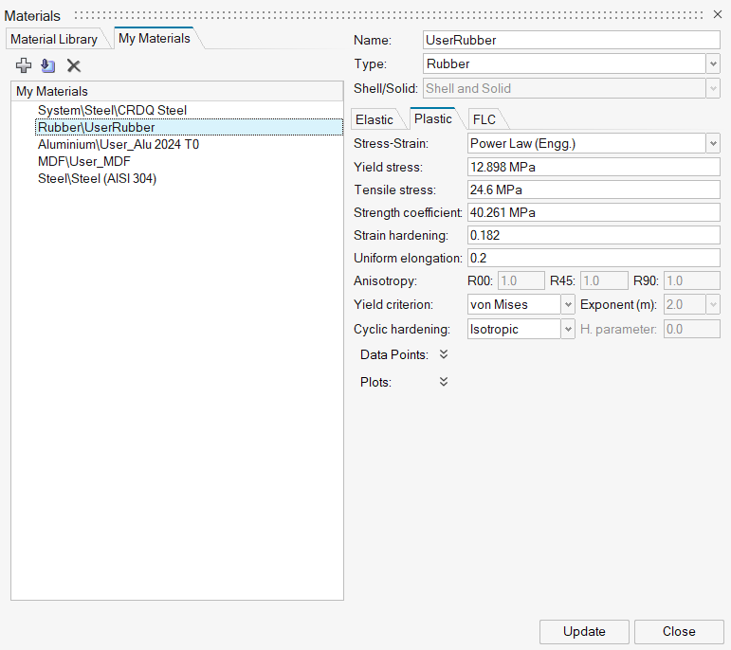
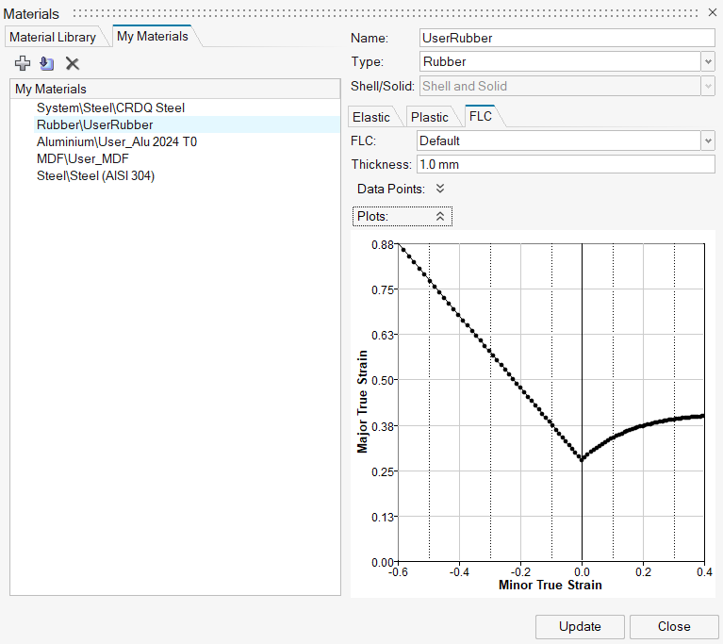
Materials (3/4)
Rubber (Urethane)

Slide 20
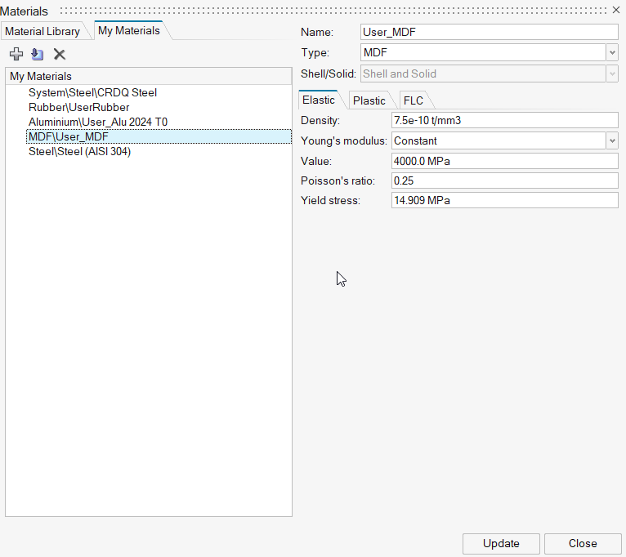
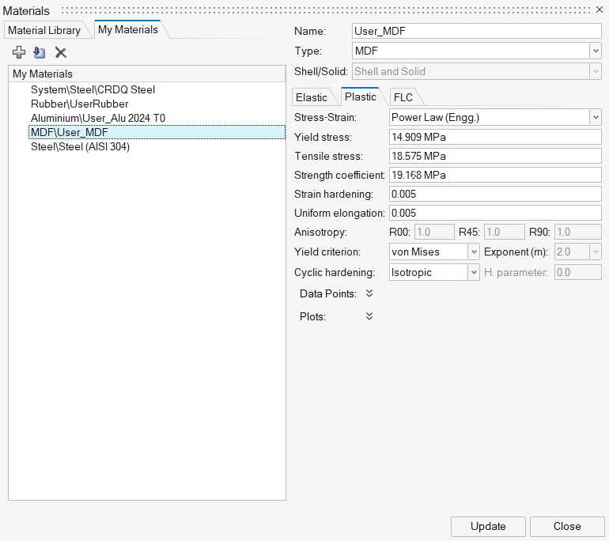
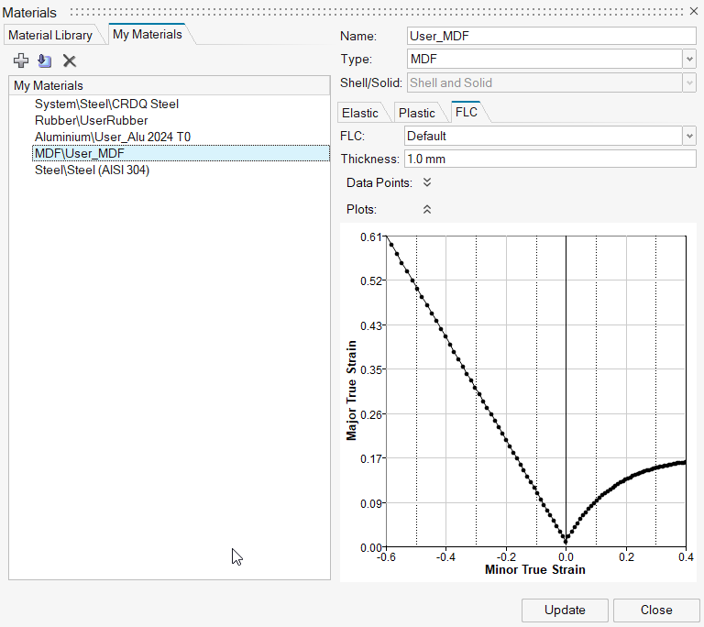
Materials (4/4)
Medium-Density Fiberboard

Slide 21
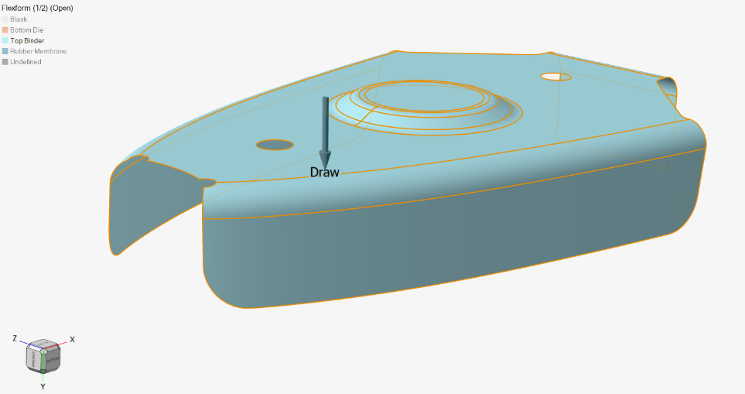
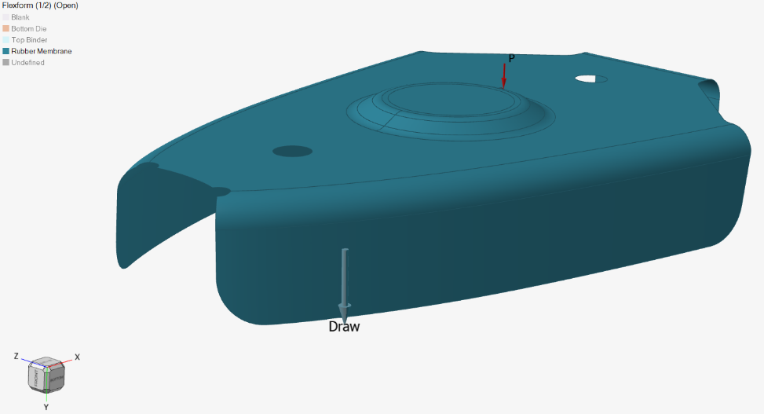
Tool Set (1/6)
Horizontal Stabilizer (HS) – Leading Edge (LE) Rib – Flexform setup
Top Binder
Rubber Membrane
The pressure of 13.6 MPa applied on the rubber and binder corresponds to the 3000tf actual applied in the hydraulic press.

Slide 22
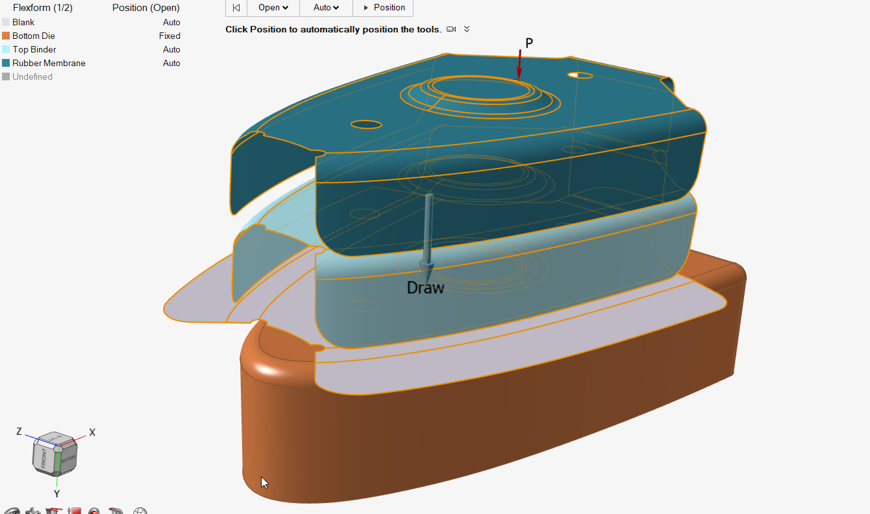
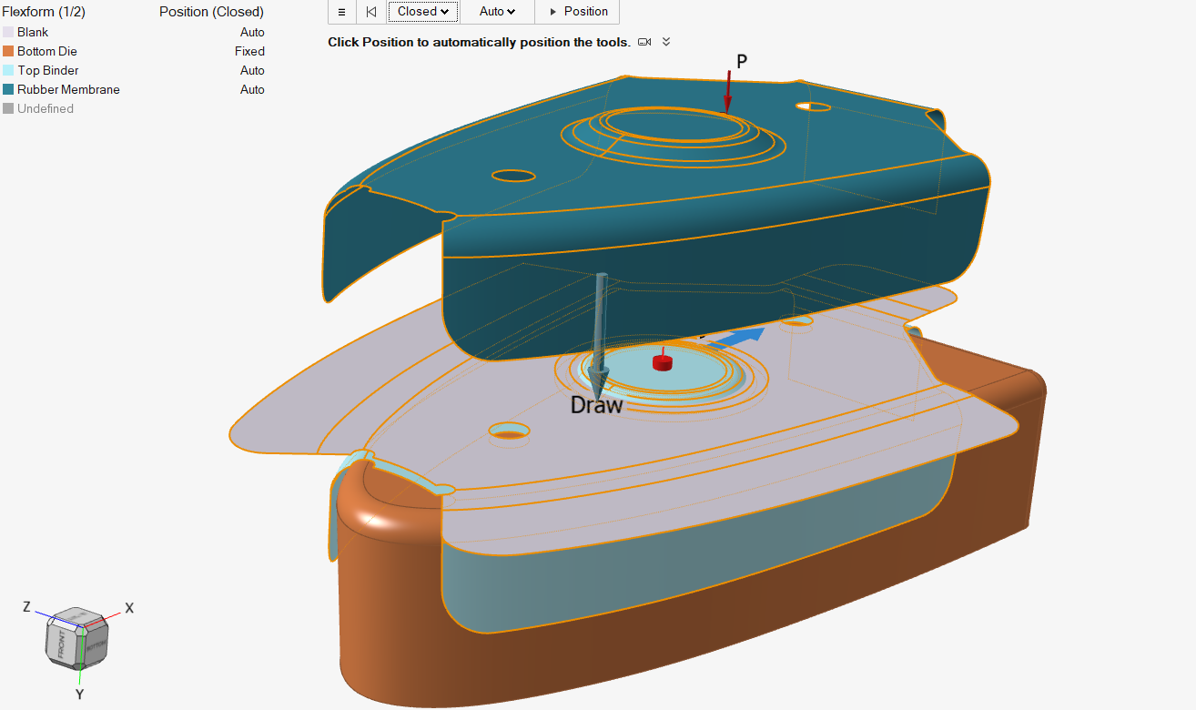
Tool Set (2/6)
Horizontal Stabilizer (HS) – Leading Edge (LE) Rib – Flexform setup
Open
Closed

Slide 23
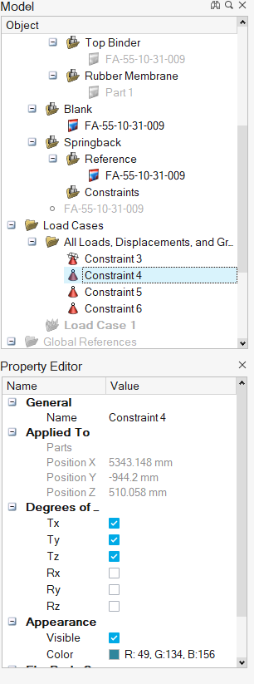
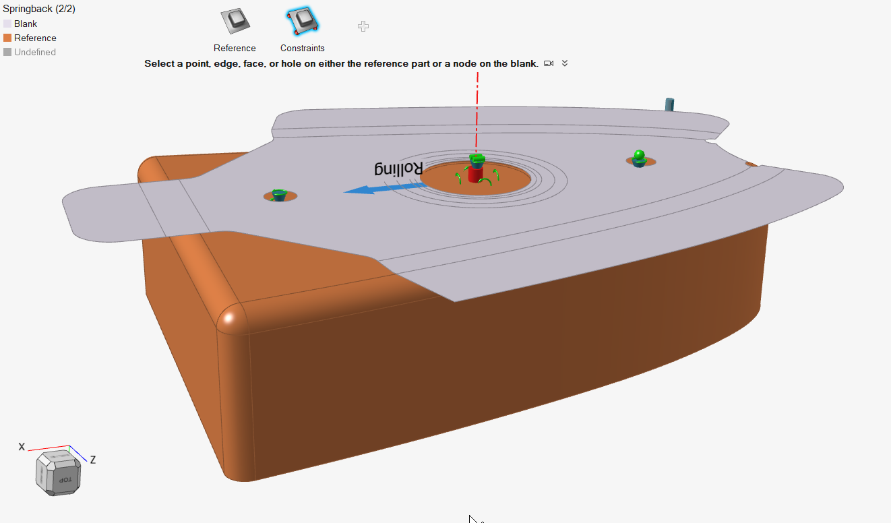
Tool Set (3/6)
Horizontal Stabilizer (HS) – Leading Edge (LE) Rib – Spring back setup

Slide 24
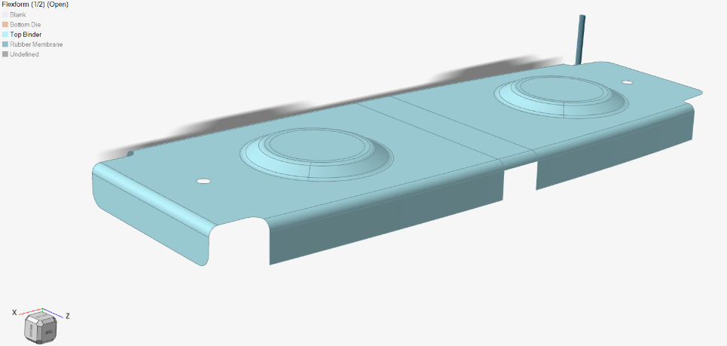
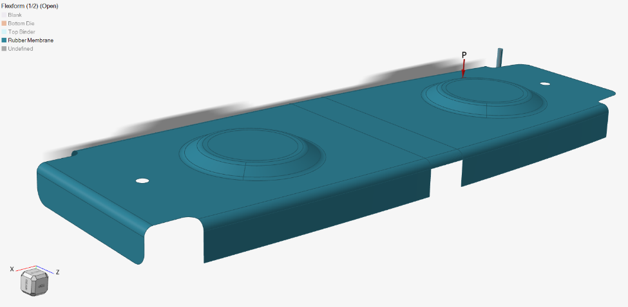
Tool Set (4/6)
Horizontal Stabilizer (HS) – Central Rib – Flexform setup
Top Binder
Rubber Membrane
The pressure of 13.6 MPa applied on the rubber and binder corresponds to the 3000tf actual applied in the hydraulic press.

Slide 25
Tool Set (5/6)
Horizontal Stabilizer (HS) – Central Rib – Flexform setup
Open
Closed

Slide 26
Tool Set (6/6)
Horizontal Stabilizer (HS) – Central Rib – Spring back setup
The pressure of 13.6 MPa applied on the rubber and binder corresponds to the 3000tf actual applied in the hydraulic press.

Slide 27
Run Options
Due to mismatch between actual system capabilities (e.g. 16GB RAM) and recommended system requirements (32 GB RAM, but 8 GB is the minimum) and in the absence of a server, a very refined mesh was not ideal due to the high amount of time spent on a run or due to other technical issues.

Slide 28
Results (1/19)
The flexform and spring back simulations provide a large variety of results which might be interesting not only for the Manufacturing or Design Departments, but also for Stress and Material & Processes Departments.
The results provided are Thinning, Edge displacement, Formability, Strain Tensor, Plastic Strain, Edge Strain, Equivalent Stress, Contact Force, but not only.
For this presentation just a few of the results which are interesting also for the spring back analysis have been chosen to be presented.

Slide 29
Results (2/19)
HS Leading Edge (LE) Rib – Flexform simulation (with thinning)

Slide 30
Results (3/19)
HS Leading Edge (LE) Rib – Blank forming (with thinning)

Slide 31
Results (4/19)
HS Leading Edge (LE) Rib – Blank forming (with thinning)

Slide 32
Results (5/19)
HS Leading Edge (LE) Rib – Blank Formability and Forming Limit Diagram

Slide 33
Results (6/19)
HS Leading Edge (LE) Rib – Blank Formability

Slide 34
Results (7/19)
HS Leading Edge (LE) Rib – Edge displacement

Slide 35
Results (8/19)
HS Leading Edge (LE) Rib – Strains tensor

Slide 36
Results (9/19)
HS Central Rib – Flexform simulation (with thinning)

Slide 37
Results (10/19)
HS Central Rib – Blank forming (with thinning)

Slide 38
Results (11/19)
HS Central Rib – Blank forming (with thinning)

Slide 39
Results (12/19)
HS Central Rib – Blank Formability and Forming Limit Diagram

Slide 40
Results (13/19)
HS Central Rib – Blank Formability

Slide 41
Results (14/19)
HS Central Rib – Edge displacement

Slide 42
Results (15/19)
HS Central Rib – Strains tensor

Slide 43
Results (16/19)
HS Leading Edge (LE) Rib – Spring back results
Considering the flange width of 12mm, the spring back angle is calculated and it is equal to 3.3⁰.

Slide 44
Results (17/19)
HS Central Rib – Spring back results
Considering the flange width of 12mm, the spring back angle is calculated and it is equal to 3.8⁰.

Slide 45
Results (18/19)
HS Leading Edge (LE) Rib – Actual measurements
The wrinkles visible in the simulation results are present also on actual part

Slide 46
Results (19/19)
HS Leading Edge (LE) Rib – Actual measurements
Actual spring back angle is 2⁰.

Slide 47
Conclusions (1/5)
The slightly difference in the spring back degree (simulation results vs. actual measurements) may be caused by the mesh size, the applied load (3000tf within the simulation vs 5000tf for the second test in production) and material properties which are not very accurate (MDF, rubber).
The accuracy of the results can be improved by using the actual material properties and a refined mesh for the model. During several simulations, it has been noticed that the unfolded sheet metal rib (so called blank) deforms up to a certain value of the applied pressure, beyond this value only a deformation of the rubber membrane is noticeable.
The flange wrinkles and their approx. location are predicted by the simulation.

Slide 48
Conclusions (2/5)
Altair Inspire Form software is a powerful tool which:
can be used by the user to simplify the geometry features of the model which will be further analyzed;
saves materials, time and costs which are wasted within production with the actual part forming tests by predicting the part final form and the non-conformities which might occur during the forming process (e.g. wrinkles, out of tolerance radius or contour);
can be used to improve the part design, not only of the sheet metal part (e.g. cutouts), but also of the die by using the die compensate module.
These conclusions were drawn after approx. 200 simulations. Several tests were performed in order to compare the influence of geometry (e.g. with or without cutouts, different membrane shapes, etc.), materials (e.g. natural rubber vs urethane), case setup (e.g. different mesh sizes).

Slide 49
Conclusions (3/5)
Influence of the cutouts in the LE Rib - geometry

Slide 50
Conclusions (4/5)
Influence of the cutouts in the LE Rib - thinning

Slide 51
Conclusions (5/5)
Influence of the cutouts in the LE Rib - formability

Slide 52
Thank you for your attention

